Slide 1


Why Agents, MAS, and RAG?
by Braga Basil
Notes:
Agents, multi-agent systems (MAS), and reinforcement learning for autonomous generation (RAG) are powerful tools for building intelligent, adaptive systems Agents are autonomous entities that can perceive their environment, make decisions, and take actions to achieve their goals MAS allow multiple agents to work together, coordinate, and solve complex problems in a distributed way RAG combines reinforcement learning with agent-based approaches, enabling agents to learn and improve their behaviors through interaction and feedback These technologies are highly relevant for a wide range of applications, from robotics and automation to simulation and game design They allow us to create systems that can adapt, learn, and collaborate in dynamic, unpredictable environments The combination of agents, MAS, and RAG offers exciting possibilities for the future of AI and intelligent systems

Slide 2

What Is an Intelligent Agent?
Perceives environment
An agent actively monitors and senses its surroundings
Maintains internal state / memory
Stores and updates information about past experiences
Plans and acts toward goals
Sets objectives and takes actions to achieve them
Interacts with other agents, tools, and humans
Communicates and collaborates with various entities
An agent is an autonomous system that: ✅ Perceives environment ✅ Maintains internal state / memory ✅ Plans and acts toward goals ✅ Interacts with other agents, tools, and humans
Agents ≠ LLMs Agents = LLM + memory + tools + autonomy + coordination
Notes:
An agent is an autonomous system that can perceive its environment, maintain an internal state and memory, plan and act towards goals, and interact with other agents, tools, and humans. Agents are more than just large language models (LLMs). Agents combine an LLM with memory, tools, autonomy, and the ability to coordinate. The key capabilities of an intelligent agent are: perceiving the environment, maintaining internal state and memory, planning and acting towards goals, and interacting with other entities. Agents are not passive systems, but actively monitor their surroundings, store and update information about past experiences, set objectives, and take actions to achieve them. Agents can communicate and collaborate with various other agents, tools, and humans to accomplish their goals.

Slide 3
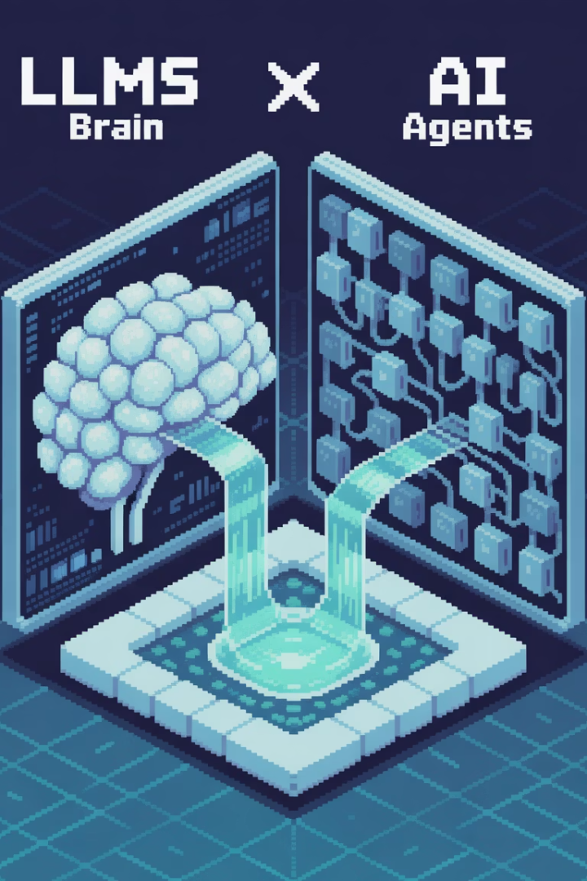
From LLMs to Agents
LLMs Limitations
Agent Advantages
Forget context between calls
Persistent memory
Lack self-directed planning
Multi-step reasoning
Don't maintain state or memory
Tool use (APIs, databases, browser)
Can't manage complex workflows
Autonomous cycles
LLMs are great — but they: ❌ Forget context between calls ❌ Lack self-directed planning ❌ Don't maintain state or memory ❌ Can't manage complex workflows
Agents add: ✅ Persistent memory ✅ Multi-step reasoning ✅ Tool use (APIs, databases, browser) ✅ Autonomous cycles
Notes:
The slide outlines the key limitations of large language models (LLMs) and the advantages that AI agents can provide to address those limitations. LLMs struggle with maintaining context, lack self-directed planning, don't maintain state or memory, and can't manage complex workflows. In contrast, AI agents offer persistent memory, multi-step reasoning, the ability to use external tools and APIs, and autonomous execution of tasks. I'll highlight how these agent capabilities can unlock new applications and use cases that go beyond what is possible with traditional LLMs alone.

Slide 4






The Agent Autonomy Cycle
Plan
Act
What should I do next?
Execute actions
Reflect & Update State
Observe
Learn from outcomes
Perceive results
The agent loop: 1️⃣ Plan — What should I do next? 2️⃣ Act — Execute actions 3️⃣ Observe — Perceive results 4️⃣ Reflect & Update State 5️⃣ Repeat
→ This is how agents evolve behavior over time.
Notes:
The agent autonomy cycle is a fundamental process that describes how intelligent agents, whether human or artificial, evolve their behavior over time. It consists of 4 key steps: Plan, Act, Observe, and Reflect & Update State. In the Planning stage, the agent considers what actions to take next based on their current understanding and goals. They then Execute those actions in the Act stage. The Observe stage involves perceiving the results of those actions and gathering new information. Finally, the agent Reflects on the outcomes and Updates their internal state and knowledge to inform future decisions. This cyclical process allows the agent to continuously learn and improve their behavior through experience. It's a powerful framework for understanding how intelligent systems, including ourselves, develop and adapt over time.

Slide 5



Multi-Agent Systems (MAS)
Multiple agents interacting
Each agent may have different knowledge, role, goal
System behavior emerges from agent interactions
Agents communicate and coordinate to achieve goals
Complex behaviors arise from simple agent rules
Specialized agents contribute unique capabilities
A Multi-Agent System is:
- Multiple agents interacting
- Each agent may have different knowledge, role, goal
- System behavior emerges from agent interactions
Why MAS? → Complex tasks → require distributed intelligence → MAS can scale and adapt dynamically → MAS can exhibit emergent properties
Notes:
Multi-Agent Systems involve multiple agents that interact and coordinate to achieve their goals Each agent may have different knowledge, roles, and objectives, contributing unique capabilities to the system The overall system behavior emerges from the interactions between these specialized agents This distributed intelligence allows MAS to scale and adapt dynamically, exhibiting complex emergent properties that cannot be achieved by a single centralized system MAS are well-suited for tackling complex tasks that require distributed problem-solving capabilities

Slide 6





MAS Coordination Patterns
Master-worker
Peer-to-peer
Marketplace/auction
Hierarchical
Centralized control structure
Fully distributed coordination
Agents bid for tasks
Leader + sub-agents structure
Swarm
Simple local rules → global behavior
Common patterns: 🔹 Master-worker → centralized control 🔹 Peer-to-peer → fully distributed 🔹 Marketplace/auction → agents bid for tasks 🔹 Hierarchical → leader + sub-agents 🔹 Swarm → simple local rules → global behavior
Emergence = key property: system behaviors that are not obvious from agent design.
Notes:
MAS coordination patterns are the different ways that multi-agent systems can be structured and organized We'll cover 5 common patterns: master-worker, peer-to-peer, marketplace/auction, hierarchical, and swarm Master-worker has a centralized control structure, with a central coordinator directing the workers Peer-to-peer is fully distributed, with agents coordinating directly with each other Marketplace/auction has agents bidding for tasks or resources Hierarchical has a leader agent with sub-agents underneath Swarm coordination relies on simple local rules that lead to complex global behaviors Emergence is a key property of MAS - the system behaviors that arise are not always obvious from the individual agent designs

Slide 7






RAG: Enabling Agent Memory & Knowledge
Shared Memory Spaces
Collective knowledge repository
Specialized Agent Memory
Role-specific knowledge per agent
Embedding-based Retrieval
Semantic search across documents
Dynamic Knowledge Injection
Real-time information updates
Retrieval-Augmented Generation (RAG): ✅ Embedding-based retrieval from documents & data ✅ Dynamic knowledge injection into agents ✅ Enables shared memory spaces ✅ Enables specialized agent memory (per agent) ✅ Agents can update and contribute to shared memory
RAG = the glue that makes agent societies smarter.
Notes:
RAG enables agents to have shared memory spaces - a collective knowledge repository that all agents can access Agents also have specialized memory tailored to their specific roles and responsibilities RAG uses embedding-based retrieval to allow semantic search across the shared documents and data The system also supports dynamic knowledge injection, allowing agents to update the shared memory in real-time This shared and specialized memory, combined with the flexible retrieval and update capabilities, is the "glue" that makes agent societies smarter and more capable

Slide 8
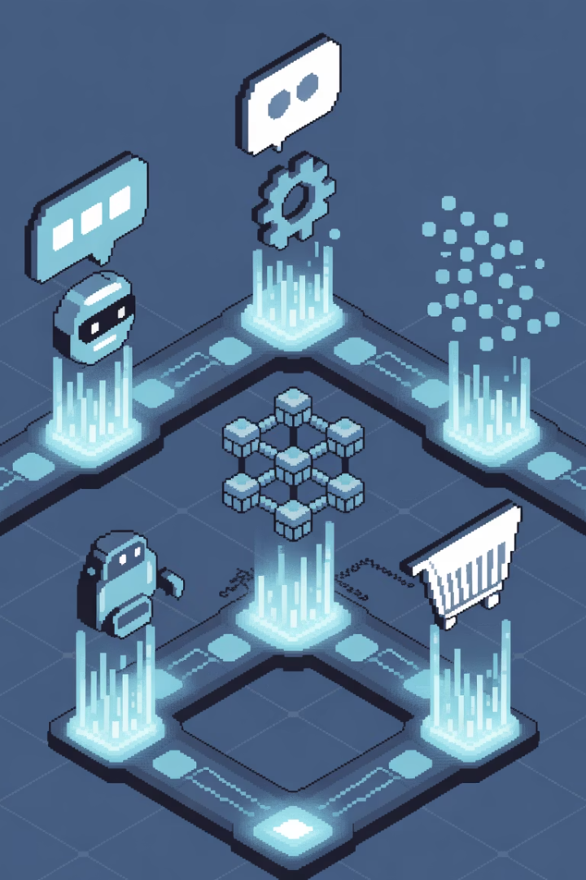





Example Architectures of Agent Systems
Conversational agent
Interactive dialogue systems
Workflow agent
Process automation systems
Agent society (MAS)
Collaborative multi-agent systems
Marketplace / auction agents
Economic transaction systems
Swarm agents
Emergent collective behavior
Common architectures: 🗨️ Conversational agent 🔄 Workflow agent 🕸️ Agent society (MAS) 🤝 Marketplace / auction agents 🧭 Swarm agents
Agents can: → Talk to each other → Use tools / APIs → Share memory → Learn from experience
Notes:
This slide provides an overview of different architectures for agent-based systems We have 5 key types of agent systems illustrated here: Conversational agents - interactive dialogue systems Workflow agents - process automation systems Multi-agent systems (MAS) - collaborative agent societies Marketplace/auction agents - economic transaction systems Swarm agents - emergent collective behavior These agent systems share common capabilities - they can communicate, use tools/APIs, share memory, and learn from experience The visual metaphors and icons help illustrate the key characteristics of each agent type This sets the stage for a deeper dive into the specific use cases and technical implementations of these agent architectures

Slide 9




Real-World MAS & RAG Examples
LangChain Agents
Tools + memory integration
CrewAI
Multi-agent orchestration
LangGraph
Dynamic agent workflows
OpenDevin
Multi-agent code solving
AlphaStar
Emergent MAS in games
✅ LangChain Agents with tools + memory ✅ CrewAI multi-agent orchestration ✅ LangGraph → dynamic agent workflows ✅ OpenDevin → multi-agent code solving ✅ AlphaStar (StarCraft) → emergent MAS in games ✅ Agent-based modeling → traffic, energy grids, finance
MAS is a general AI design paradigm — not tied to any single framework.
Notes:
This slide provides an overview of real-world examples of multi-agent systems (MAS) and related technologies. We'll start by looking at LangChain Agents, which integrate tools and memory to enable powerful agent-based applications. Next, we'll discuss CrewAI, a system for orchestrating multiple agents to work together on complex tasks. LangGraph demonstrates how we can create dynamic workflows that allow agents to adapt and collaborate in real-time. OpenDevin is an example of using MAS to solve complex coding problems by dividing the work across multiple specialized agents. Finally, we'll look at AlphaStar, an AI system that uses emergent multi-agent behaviors to excel at the game StarCraft. The key takeaway is that MAS is a general AI design paradigm that can be applied to a wide range of real-world problems, from traffic modeling to finance.

Slide 10
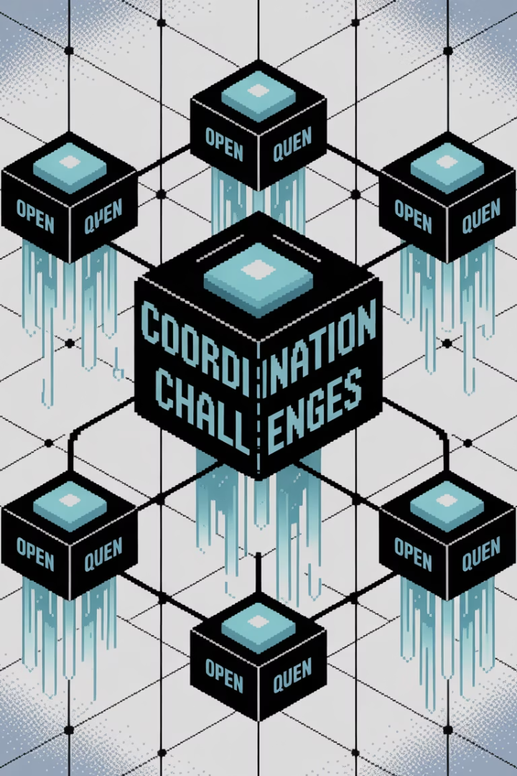
Open Questions & Future Trends
1
2
3
Coordination Challenge
Role Evolution
Behavior Alignment
How to manage evolving agent roles?
How to align emergent behaviors?
How to coordinate large agent societies?
4
Safety & Alignment
How to ensure agent safety and alignment?
🚀 How to coordinate large agent societies? 🚀 How to manage evolving agent roles? 🚀 How to align emergent behaviors? 🚀 How to make agents self-reflect and self-improve? 🚀 How to ensure agent safety and alignment?
→ This field is open and evolving — today, you start building agent societies.
Notes:
The key open questions we're exploring in multi-agent systems include: How to coordinate large societies of agents to work together effectively Managing the evolution of agent roles and responsibilities over time Aligning the emergent behaviors that arise in complex multi-agent systems Ensuring the safety and alignment of agent goals with human values These are active areas of research - there's still a lot to explore and discover in this field Today, we'll start building our own agent societies and grappling with these challenges

